Slide 1


Exploring an Eye Tracking Technique for Activity Recognition and Interaction Design
Eric Lu
Supervisor: Khai N. truong

Slide 2
Physiology of Eye Movements
Saccades
A rapid movement of the eye between fixation points, with 20 degrees for the amplitude and 10~100ms for the duration.
Fixations
Stationary state of the eyes during which gaze is help upon a specific location in the visual scene. Lasts around 100~200 ms.
Blink
Regular opening and closing of eyelids. Around 12~19 times per minute at rest. Duration lies between 100 and 400 ms.
Eye Movement Analysis for Activity Recognition Using Electrooculography, Bulling et al. 2011

Slide 3

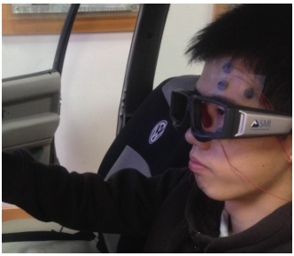
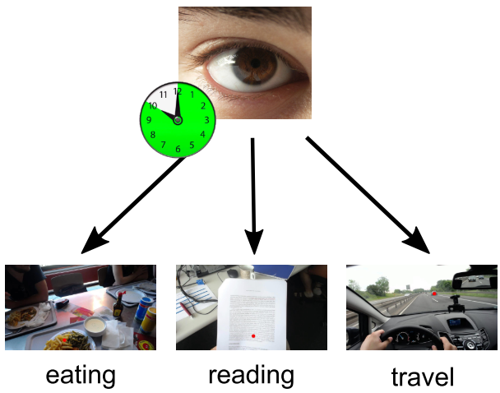
Background
Why are we interested in eye movement tracking?
- Eye movements can convey useful information about humans.
Rapid eye movement
(ScienceDaily, n.d.)
A Novel Approach to Driving Fatigue Detection Using Forehead EOG
Zhang, Gao, Zhu, Zheng, & Lu, 2015
Discovery of Everyday Human Activities From Long-Term Visual Behaviour Using Topic Models
Steil & Bulling, 2015

Slide 4
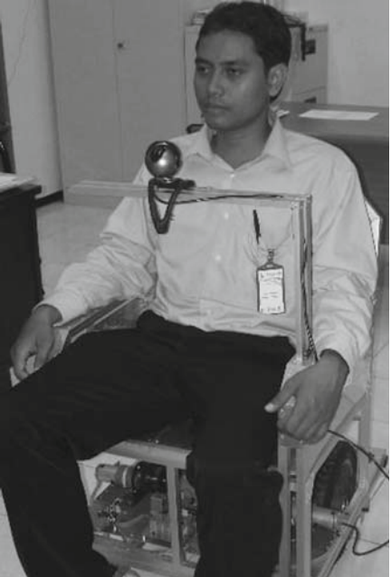
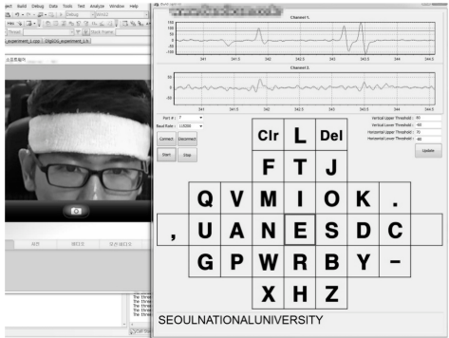
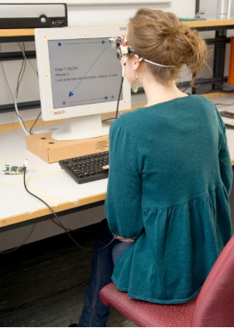
Background
Why are we interested in eye movement tracking?
- Serves as an alternative input interface.
Electric wheelchair control with gaze direction and eye blinking Purwanto, Mardiyanto, and Arai 2009
A novel wearable forehead EOG measurement system for human computer interfaces
Heo, Yoon, and Park 2017
Wearable EOG Goggles: Eye-Based Interaction in Everyday Environments
Bulling, Roggen, and Tröster 2009

Slide 5

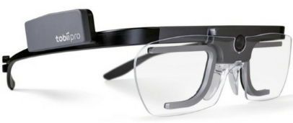
Background
Some of the existing sensing modalities
- Camera-based approach.
Tobii Eye Tracking Glasses 2
Eye tracking app on iPhone X

Slide 6
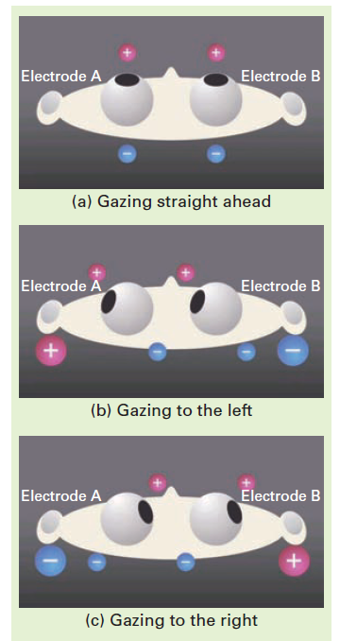
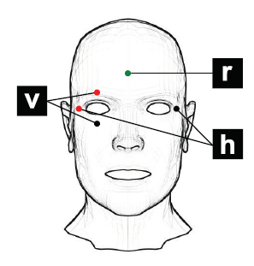
Background
Some of the existing sensing modalities
- Electro-Oculogram-based approach.
Also known as EOG.
Measuring the potential across eyes
Can capture saccades, fixations and blinks.
Wet electrodes cause discomfort.
Wet electrodes lose sensitivity over time.
Wet electrodes are disposable.

Slide 7
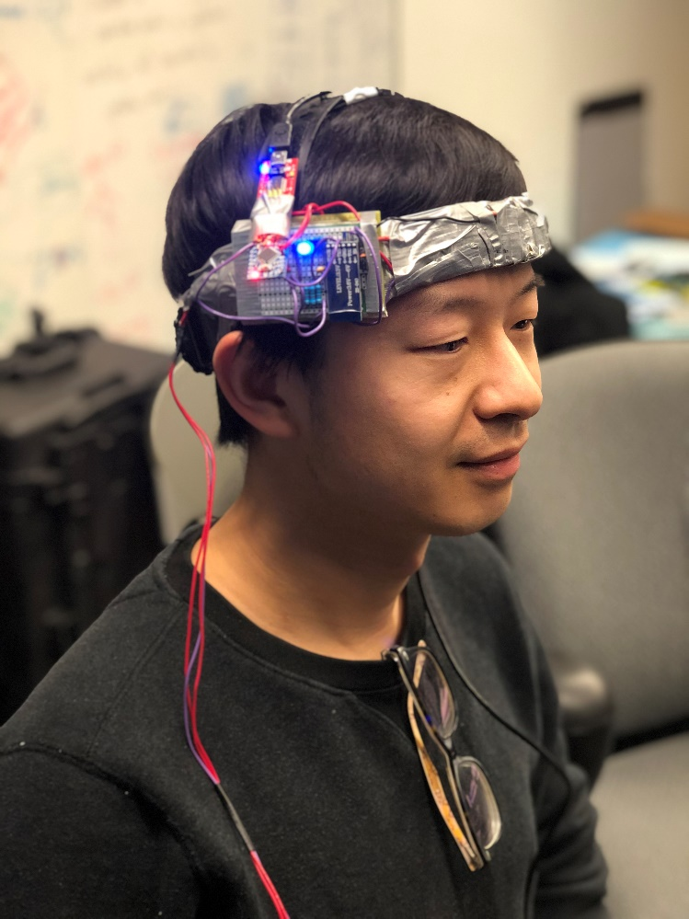
The Most Up-to-date Sensing Configuration
It is a Electro-Oculogram-based approach.
It was an interesting sensing modality.
Form factor suitable to various users.
No privacy concern.
Computationally low cost.
Economically feasible.

Slide 8
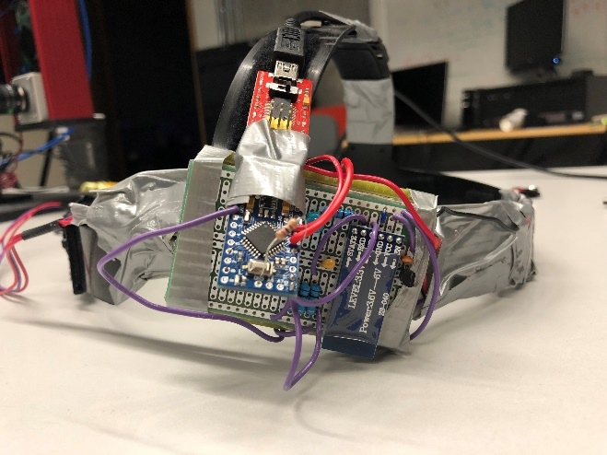
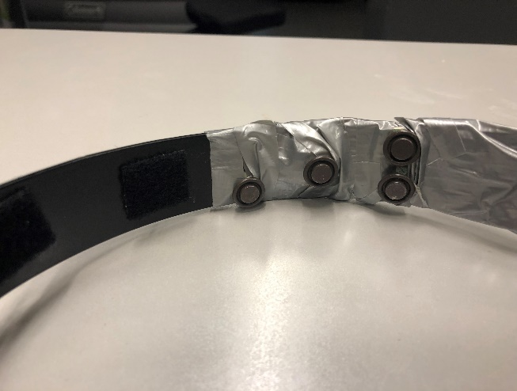
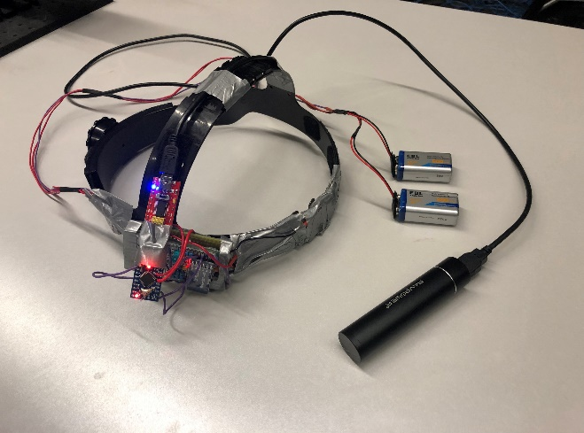
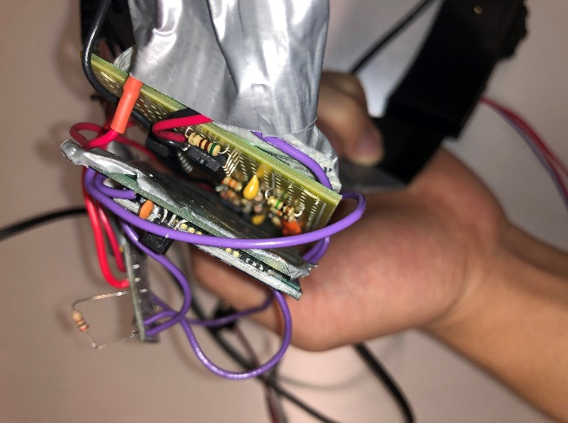
Technical Details
FTDI to USB converter
Dry electrodes
HC-05
Bluetooth module
Arduino Pro Mini
9V rechargeable batteries
Adjustable
Headband
Portable USB charger
EOG sensing circuit

Slide 9

Simplified Schematic Diagram for EOG Measurement
Arduino
ADC
Vertical
10 Hz LPF
0.01 Hz HPF
X500
X1
E1
EG
E2
E3
Horizontal
X500
10 Hz LPF
0.01 Hz HPF
X1
Sensing 0~5V
Ground

Slide 10
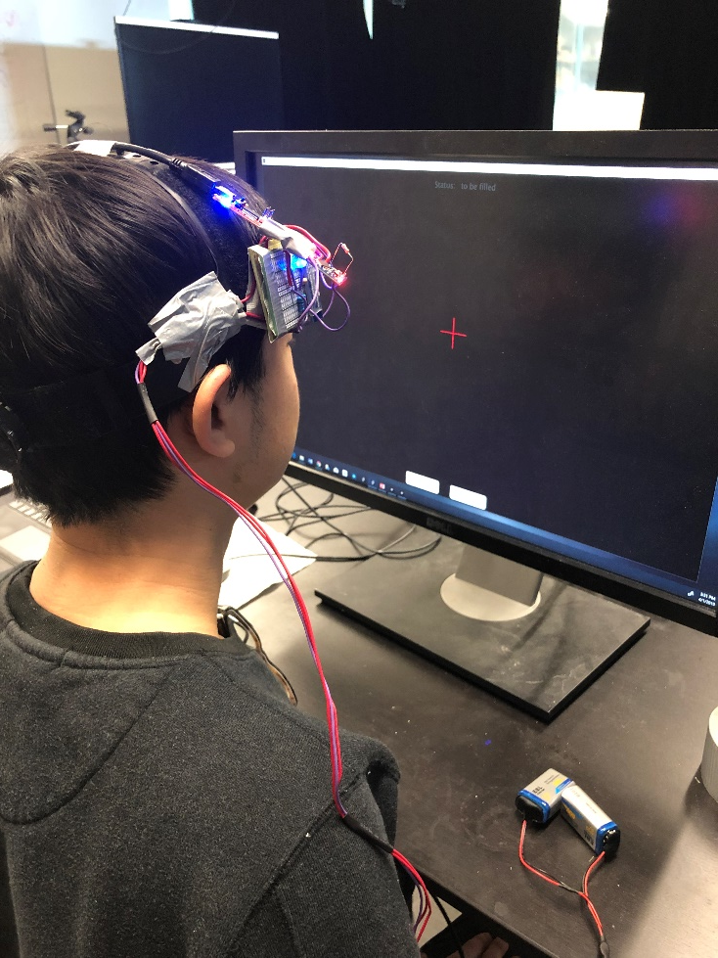
Data Collection

Slide 11
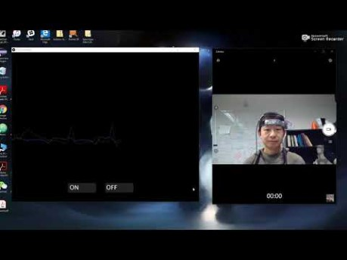
Red line: the vertical channel
Purple line: the horizontal channel
Notes:
Please pay attention to the eye movements of the subject and the corresponding change in the EOG curve

Slide 12
Data Collection
Down
Left
Right
Up

Slide 13
Future Plans and Discussions
Analyze data and extract features
Train computer to recognize eye movements
Identify what activities we are interested in tracking
Train computer to recognize activities
Analyze data and extract features
Recruit participants and collect data

Slide 14

The End
Thanks for listening!
Presented by
Eric lu

